Slide 1

Keyboard & Mouse Event using Action Class

Slide 2
Introduction
Handling keyboard and mouse events can be performed using Webdriver.
It contains the Actions and the Action classes that are needed when executing these events.

Slide 3
Method | Description
clickAndHold() | Clicks (without releasing) at the current mouse location.
contextClick() | Performs a context-click at the current mouse location.
doubleClick() | Performs a double-click at the current mouse location.
dragAndDrop(source, target) | Performs click-and-hold at the location of the source element, moves to the location of the target element, then releases the mouse. Parameters: source- element to emulate button down at. target- element to move to and release the mouse at.

Slide 4
Method | Description
dragAndDropBy(source, x-offset, y-offset) | Performs click-and-hold at the location of the source element, moves by a given offset, then releases the mouse. Parameters: source- element to emulate button down at. xOffset- horizontal move offset. yOffset- vertical move offset.
keyDown(modifier_key) | Performs a modifier key press. Does not release the modifier key - subsequent interactions may assume it's kept pressed. Parameters: modifier_key - any of the modifier keys (Keys.ALT, Keys.SHIFT, or Keys.CONTROL)

Slide 5
Method | Description
keyUp(modifier _key) | Performs a key release. Parameters: modifier_key - any of the modifier keys (Keys.ALT, Keys.SHIFT, or Keys.CONTROL)
moveByOffset(x-offset, y-offset) | Moves the mouse from its current position (or 0,0) by the given offset. Parameters: x-offset- horizontal offset. A negative value means moving the mouse left. y-offset- vertical offset. A negative value means moving the mouse down.

Slide 6
Method | Description
moveToElement(toElement) | Moves the mouse to the middle of the element. Parameters: toElement- element to move to.
release() | Releases the depressed left mouse button at the current mouse location
sendKeys(onElement, charsequence) | Sends a series of keystrokes onto the element. Parameters: onElement - element that will receive the keystrokes, usually a text field charsequence - any string value representing the sequence of keystrokes to be sent

Slide 7
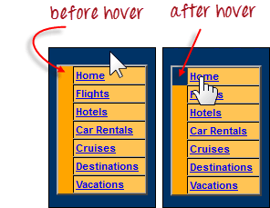
How to Implement
See the example:-
If not hovered, its colour is #FFC455 (orange). After hovering, the cell's color becomes transparent.
It becomes the same colour as the blue background of the whole orange table.

Slide 8



Import the Actions and Action classes.
Make a new Actions object.
Instantiate an Action using the Actions object.
moveToElement() method is used for moving the mouse to the middle of the element.
build() method is used for all the listed actions will be compiled into a single step.
Use the perform() method when executing the Action object we designed.
OUTPUT

Slide 9
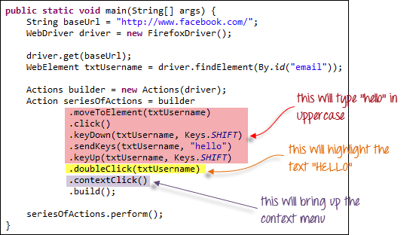
Building a Series of Multiple Actions
Building a series of actions using the Action and Actions classes.
Remember close the series with the build() method.

Slide 10
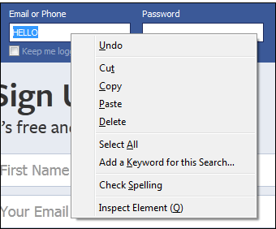
OUTPUT

Slide 11
Covered Till Now
Handling special keyboard and mouse events are done using the AdvancedUserInteractions API.
Frequently used Keyword and Mouse Events are doubleClick(), keyUp, dragAndDropBy, contextClick & sendKeys.

Slide 12
Thanks

